Slide 1

Central Coast
Long-term Environmental Assessment Network

Slide 2
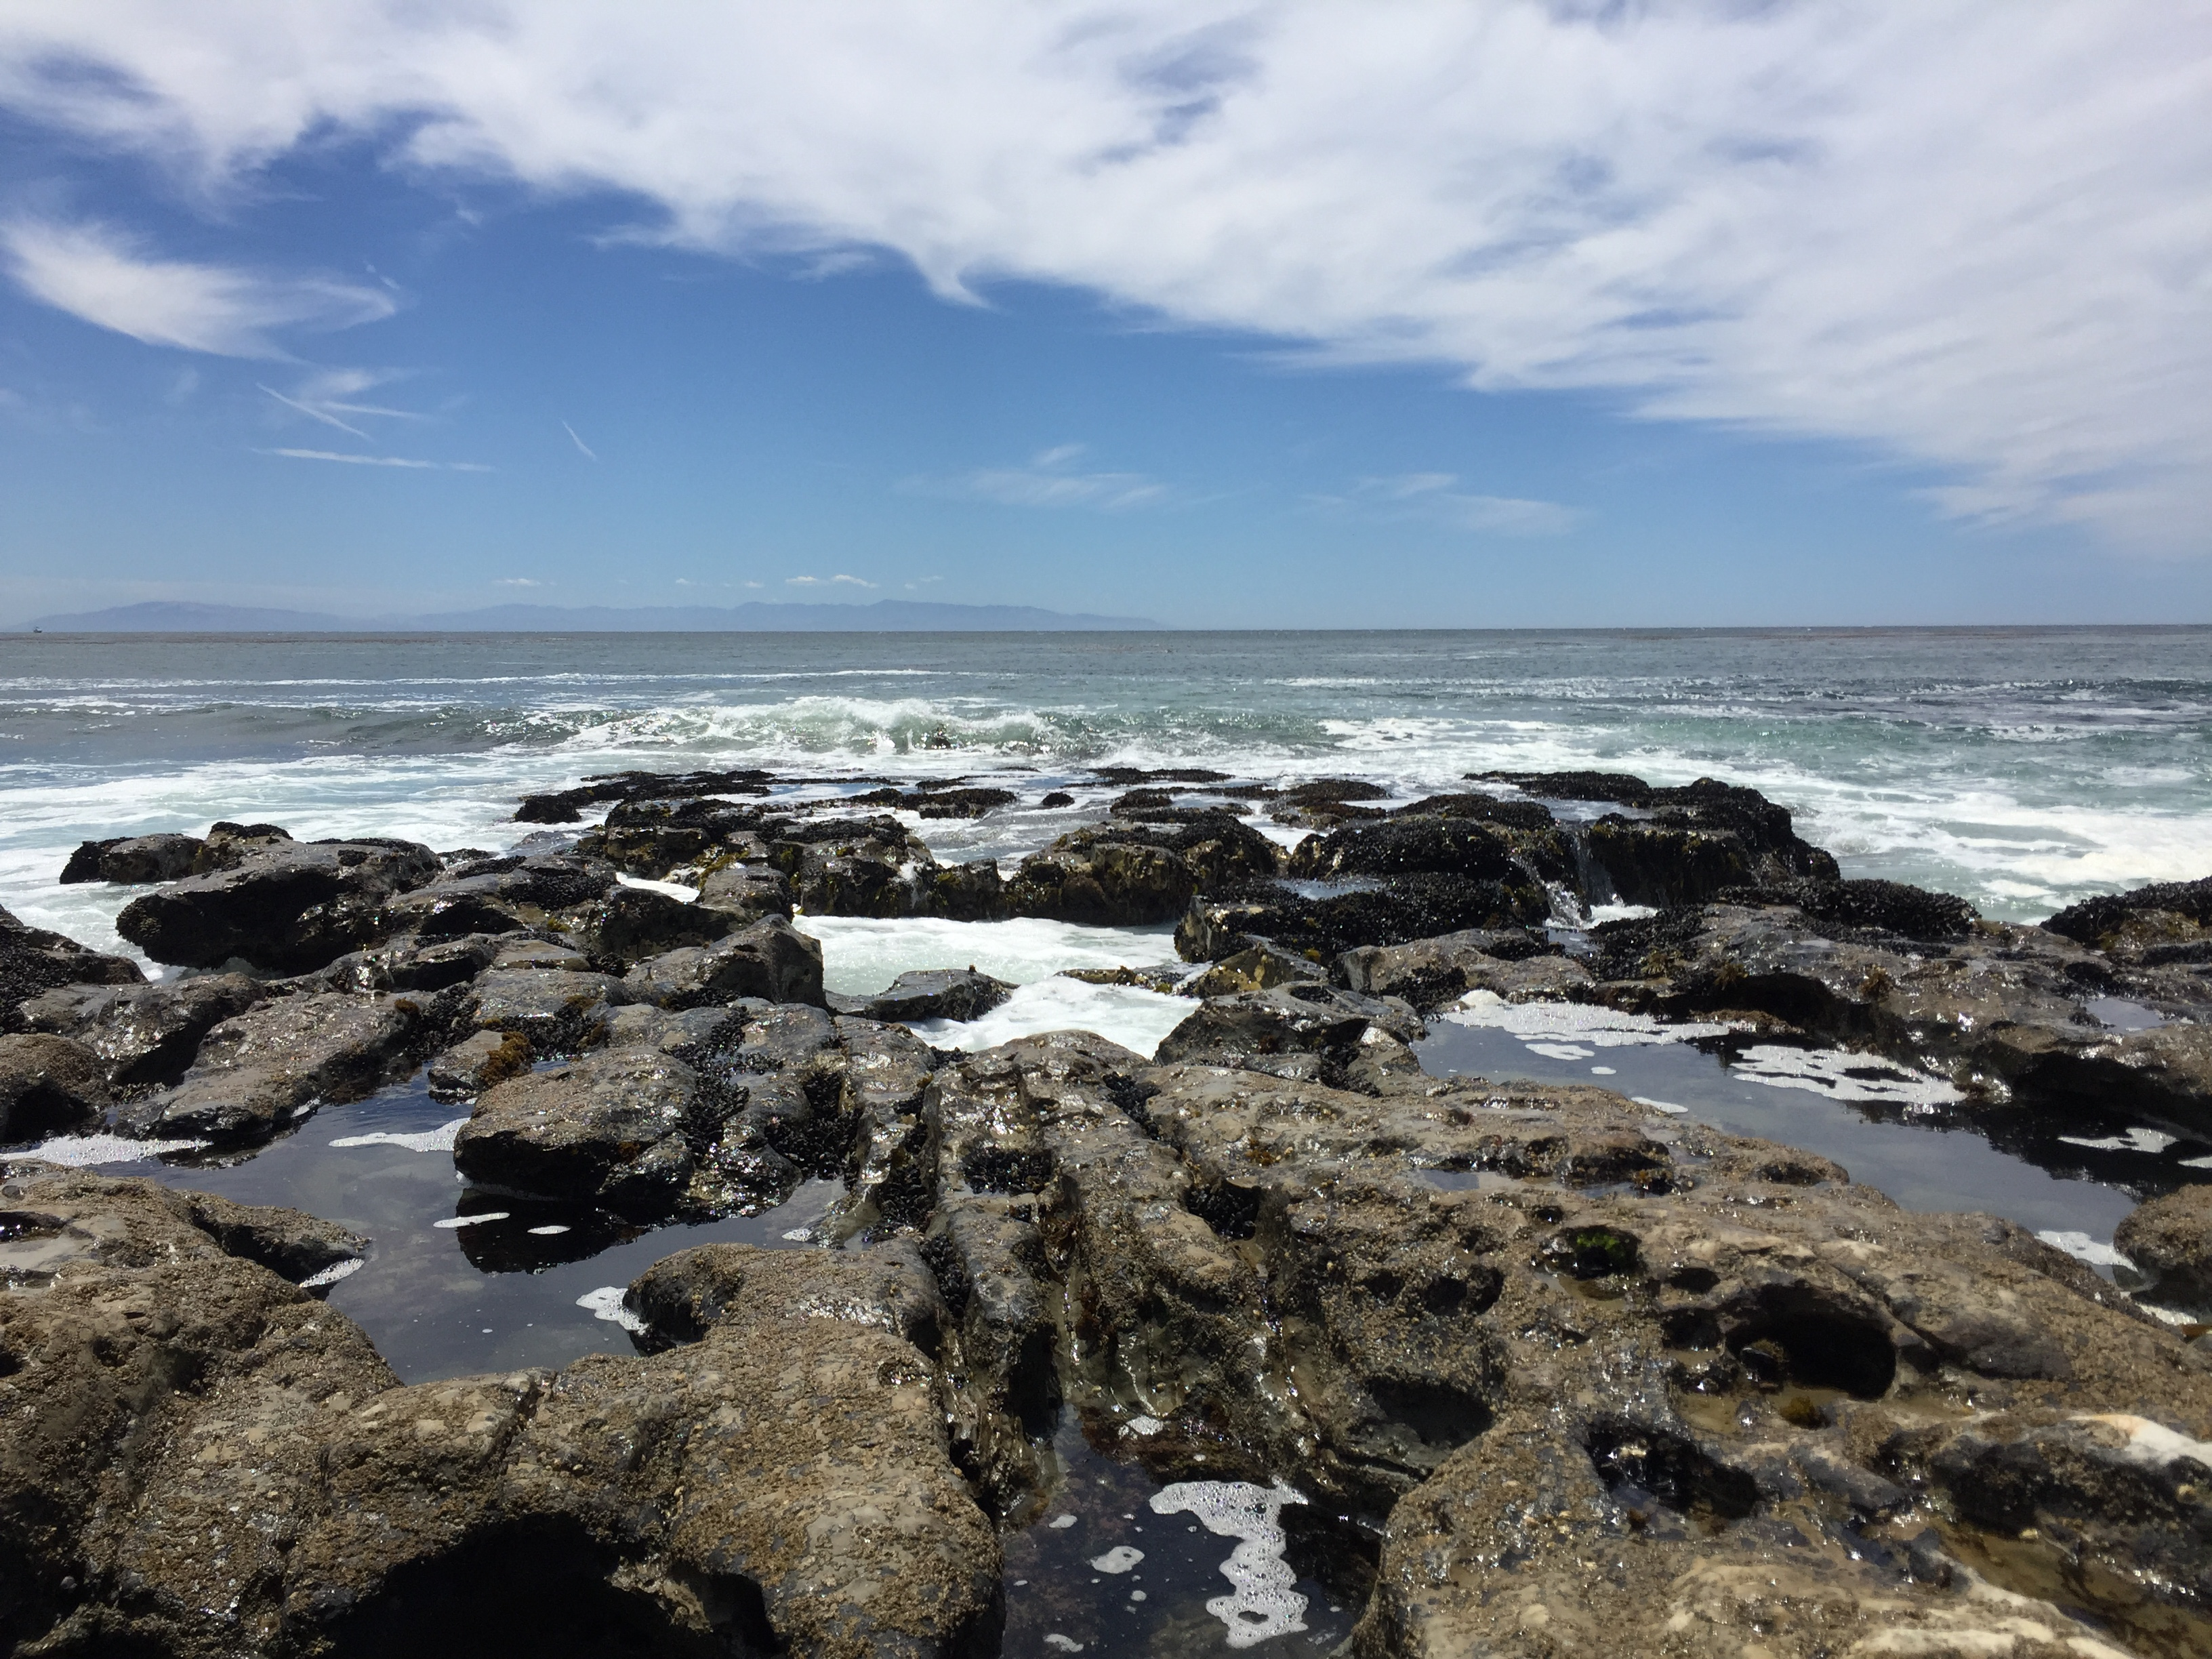
Mission
To Trace Sources, Loads and Effects of Contaminants in Ocean Waters along the Central California Coast
Established 2001

Slide 3
Key Features
Participant-driven, adaptively managed program
  Program objectives
  Participants
  Governing structure
  Cost-sharing formula

Slide 4
CCLEAN Program Objectives
1. Obtain high-quality data describing the status and long-term trends in the quality of Monterey Bay nearshore waters, sediments, and associated beneficial uses.
2. Determine whether Monterey Bay waters and sediments are in compliance with the Ocean Plan and associated NPDES permits.
3. Determine sources of contaminants to Monterey Bay nearshore waters.
4. Provide legally defensible data on the effects of wastewater discharges in Monterey Bay.

Slide 5
CCLEAN Ancillary Goals
1. Manage adaptively to ensure cost effectiveness and response to emerging issues
2. Develop a long-term database on trends in the quality of Monterey Bay waters, sediments and associated beneficial uses.
3. Ensure that the database is compatible with other regional monitoring efforts and regulatory requirements.
4. Ensure that data are presented in ways that are understandable and relevant to the needs of stakeholders.

Slide 6
Participants
City of Santa Cruz
City of Watsonville
Moss Landing Power Plant
Monterey Regional Water Pollution Control Agency
Carmel Area Wastewater District
California State Waterboard, Central Coast Region

Slide 7
Governing Structure
Memorandum of Agreement
Simple governance style
  Single governing group (Steering Committee)
  Meets monthly
Senior technical staff or district managers
  Ability to make program revisions within regulatory limits

Slide 8
Cost Sharing
Modest flat participation fee
Remainder of program costs divided according to running 5-year mean annual discharge volume

Slide 9
Water Quality Stressors Sampled Under CCLEAN
Persistent Organic Pollutants (POPs) in water, sediments, and mussel tissues
Dissolved inorganic nutrients (ammonium, nitrate, phosphate, silicate)
Fecal Indicator Bacteria (FIBs: Enterococcus, total coliform, fecal coliform)

Slide 10
POPs emphasized by CCLEAN
POP Group | Compounds measured
PAHs | Polynuclear aromatic hydrocarbons: Biphenyl, Naphthalene, 1-methylnapthalene, 2-methylnapthalene, 2,6-dimethylnapthalene, 2,3,5-trimethylnapthalene, Acenaphthene, Acenaphthylene, Anthracene, Dibenzothiophene, Fluorene, Phenanthrene, 1-methylphenanthrene, Benz(a)anthracene, Chrysene, Fluoranthene, Pyrene, Benzo(a)pyrene, Benzo(e)pyrene, Benzo(b)fluoranthene, Benzo(k)fluoranthene, Dibenz(a,h)anthracene, Perylene, Benzo(ghi)perylene, Indeno(1,2,3-cd)pyrene
DDTs | o,p’-DDT, p,p’-DDT = (1,1,1-trichloro-2,2-bis(p-chlorophenyl)ethane) o,p’-DDD, p,p’-DDD = (1,1-dichloro-2,2-bis(p-chlorophenyl)ethane) o,p’-DDE, p,p’-DDE = (1,1-dichloro-2,2-bis(p-chlorophenyl)ethylene)
Dieldrin | 1,2,3,4,10,10-hexachloro-6,7-epoxy-1,4,4α,5,6,7,8,8α-octahydro-1,4-endo,exo-5,8-dimethanonaphthalene
Chlordanes | trans-Chlordane, cis-Chlordane, trans-Nonachlor, cis-Nonachlor, Oxychlordane, Heptachlor, Heptachlor epoxide
Dioxins/Furans | TCDD, 2,3,7,8-; PeCDD, 1,2,3,7,8-; HxCDD, 1,2,3,4,7,8-; HxCDD, 1,2,3,6,7,8-; HxCDD, 1,2,3,7,8,9-; HpCDD, 1,2,3,4,6,7,8-; OCDD, 1,2,3,4,6,7,8,9-; TCDF, 2,3,7,8-; PeCDF, 1,2,3,7,8-; PeCDF, 2,3,4,7,8-; HxCDF, 1,2,3,4,7,8-; HxCDF, 1,2,3,6,7,8-; HxCDF, 1,2,3,7,8,9-; HxCDF, 2,3,4,6,7,8-; HpCDF, 1,2,3,4,6,7,8-; HpCDF, 1,2,3,4,7,8,9-

Slide 11
POPs emphasized by CCLEAN
POP Group | Compounds measured
Pyrethroids | Allethrin, Bifenthrin, Cyfluthrin, Cyhalothrin - total lambda, Cypermethrin, Danitol (Fenpropathrin), Deltamethrin/Tralomethrin, Esfenvalerate, Fenvalerate, Fluvalinate, Permethrin-cis, Permethrin-trans, Tetramethrin
Fipronils | Fipronil, Fipronil desulfinyl, Fipronil sulfide, Fipronil sulfone
PCBs | congener numbers = all 209 congeners in water; congeners 5, 8, 18, 20, 21, 28, 31, 33, 43, 44, 49, 52, 56, 60, 61, 66, 69, 70, 73, 74, 76, 80, 86, 87, 89, 90, 93, 95, 97, 99, 101, 105, 106, 110, 111, 113, 115, 116, 117, 118, 127, 128, 132, 138, 139, 141, 147, 149, 151, 153, 156, 158, 160, 163, 164, 168, 170, 174, 177, 180, 181, 182, 183, 187, 190, 194, 195, 196, 201, 203 in tissues
PBDEs | Polybrominated diphenyl ethers: congener numbers = 7, 8, 10, 11, 12, 13, 15, 17, 25, 28, 30, 32, 33, 35, 37, 47, 49, 51, 66, 71, 75, 77, 79, 85, 99, 100, 105, 116, 119, 120, 126, 128, 138, 140, 153, 154, 155, 166, 181, 183, 190, 203, 206, 207, 208, 209

Slide 12
Matrices and Sampling Frequency
Matrix | Parameters | Frequency
Rivers (San Lorenzo, Salinas, Pajaro, Carmel) | POPs, nutrients | Twice annually (wet and dry season)
Wastewater Effluent (Santa Cruz, Watsonville, Monterey, Carmel) | POPs, nutrients | Twice annually for POPs and weekly for nutrients
Monterey Bay receiving waters (Santa Cruz, Watsonville, Monterey) | FIBs | Monthly or weekly
Monterey Bay open waters (north and south) | POPs, nutrients, FIBs, TSS | Twice annually
Sediments and benthic fauna (6 sites along 80 m contour) | POPs, grain size, TOC | Annually in the dry season (sediments) and every 5 years (fauna)
Mussels (5 rocky intertidal sites) | POPs, lipid content | Annually in the wet season

Slide 13
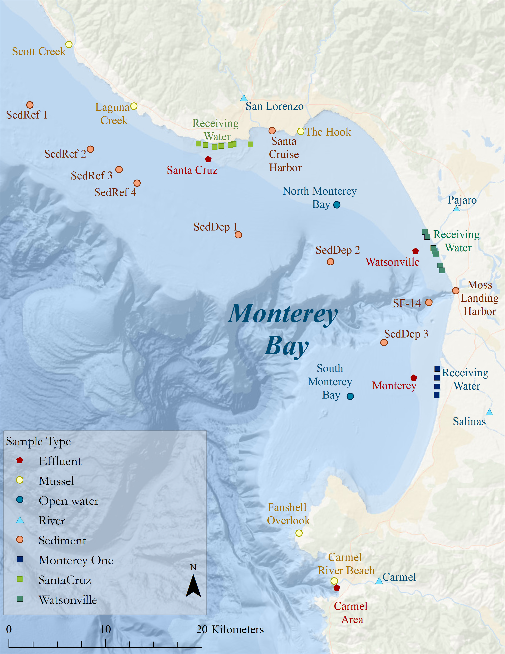
Sampling Locations

Slide 14
Monterey Bay POP concentrations 2001-2016
Water Year

Slide 15
Program Products
POP/nutrient load data
Comparison of sources
Concentrations of POPs in Monterey Bay
Special studies (physical oceanography, satellite Chlorophyll and nutrient loading)
Annual Reports – CCLEAN website
Downloadable data – CEDEN website

Slide 16
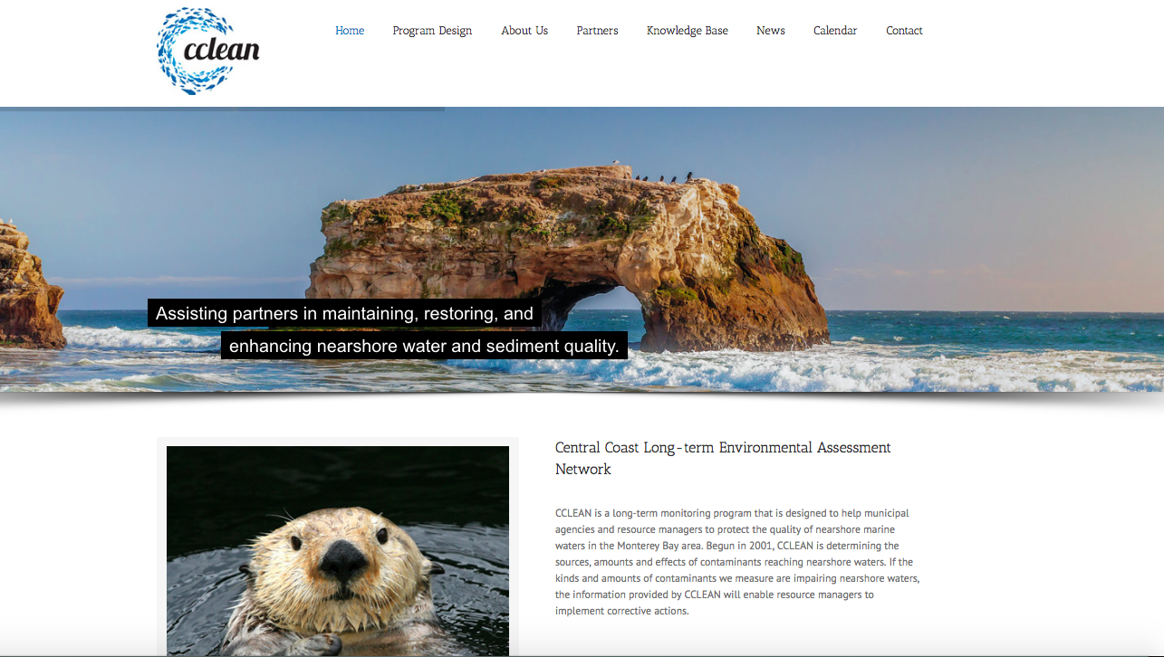
http://www.cclean.org/

Slide 17
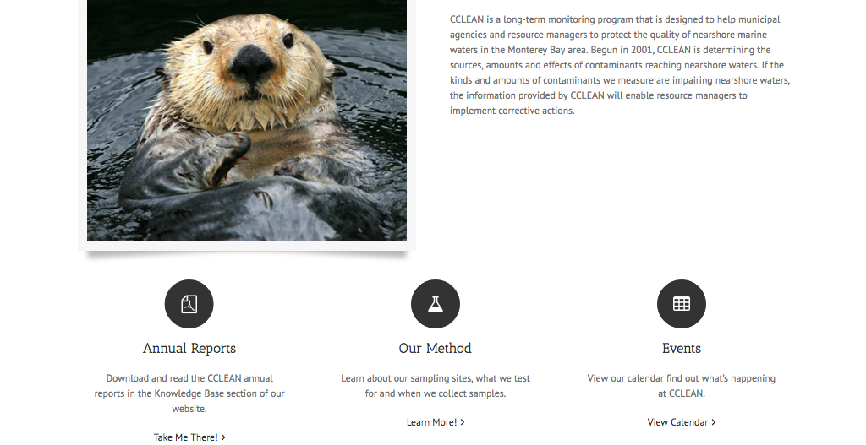

Slide 18
Potential Links to CeNCOOS

Slide 19
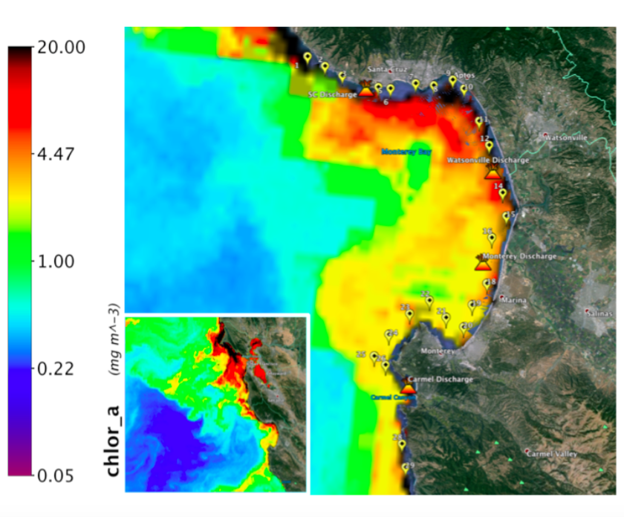
1. Chlorophyll data
Association between nutrient loads from wastewater treatment plants and ocean chlorophyll concentrations

Slide 20
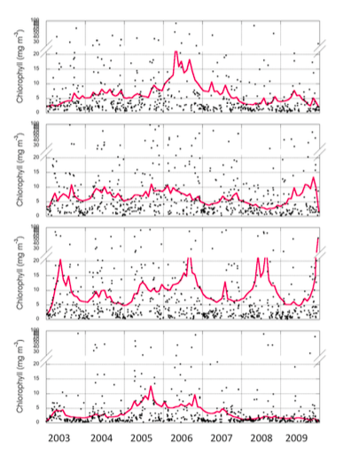
Santa Cruz
Chlorophyll concentration time series data centered on wastewater discharge locations in Monterey Bay
Watsonville
Monterey
Carmel

Slide 21
2. Climate-related data
Infauna
Examine relationship between factors, such as water temperature and pH, and decline in benthic infauna in Monterey Bay

Slide 22
3. Particle trajectories
Date | River DDT (g/day) | Ocean DDT (ng/L)
Mar-2004 | 10.9 | 0.169¹
Mar-2006 | 61.2 | 0.091
Mar-2007 | 21.5 | 0.076
Mar-2008 | 4.45 | 0.079
Mar-2009 | 10.7 | 0.099
Feb-2010 | 23.7 | 0.343
Mar-2011 | 95.7 | 0.029
Mar-2012 | 4.20 | 0.071
Apr-2013 | 0.402 | 0.104
Mar-2014 | 1.00 | 0.040
Mar-2015 | 1.25 | 0.035
Feb-2017 | 144.8 | 0.439
Obtain particle trajectories from potential sources to our sampling locations
¹Ocean Plan objective for DDT (0.17 ng/L) exceeded

